Slide 1



Data visualization project
Mohamed Khaled Mohamed 20191474372
Mina Ibrahim Sophy 20191474668
Mena Allah Ashraf Mahmoud 20191474929
Esraa elsayed Mostafa 20191475187
Sara Mohamed Mohamed Ibrahim 20191616622

Slide 2
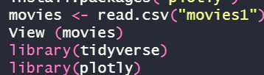
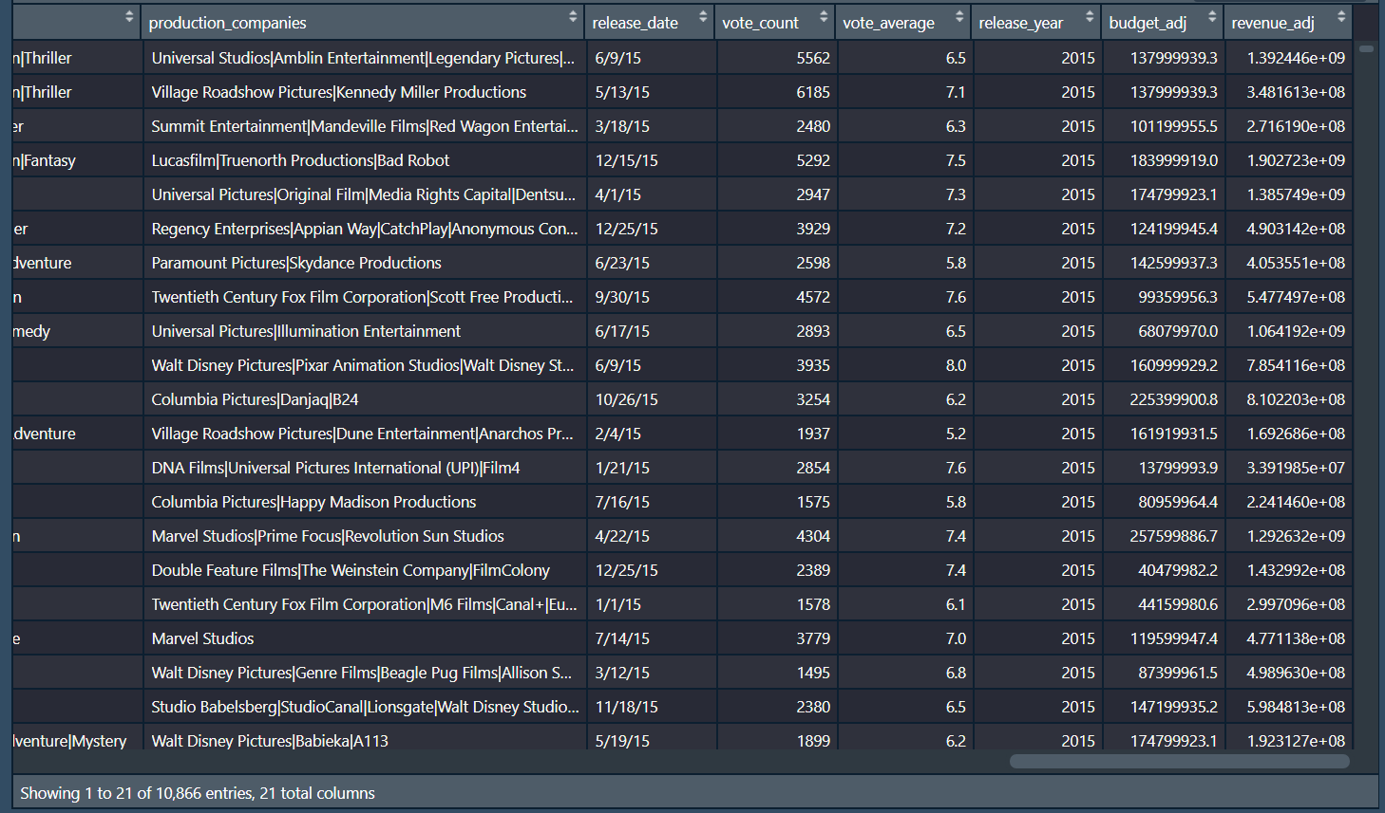
About Data
- we have a dataset consists of 10866 column and 21 row, we have id columns as a unique value corresponding to each row – entry, which on its side represents each movie with datatypes (id: int and imdb_id: object)- ➔ categorical with 10866 unique level (id) . there are other columns which describe financial values such budget and revenue (datatype : int) ➔ quantitative with minimum = “1” and maximum = “425000000” for budget minimum = “2” and maximum = “2781505847” for revenue other columns include information like the genre (datatype : object ) of this movie, the production companies (datatype : object) , the release_date (datatype : date), the crowd's votes (vote_count with datatype : int , vote_average with datatype : float) and other columns we may drop during the cleaning analysis.

Slide 3


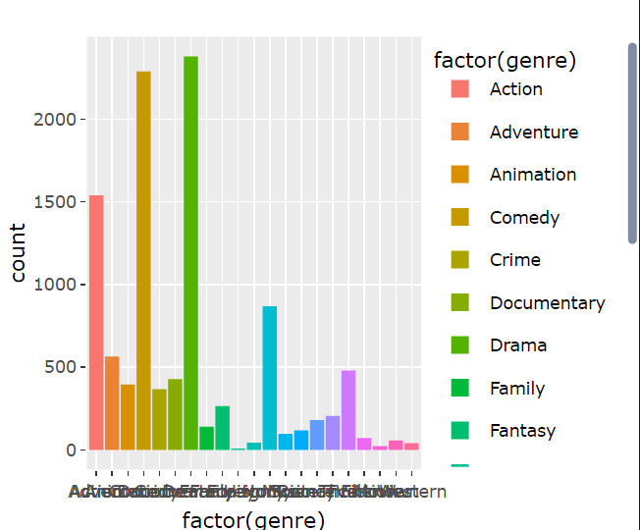
Geners of movies

Slide 4

One of the international companies called <Film Store> decided to produce a group of films in America. The company held a meeting to collect the opinions of the officials and they noticed that all the opinions revolved around choosing their favorite actors and their harmony in the roles together, but all this was just personal opinions, so the most accurate decision was to take data for a large group of films from <Kaggle>, then analyze it and work Visualize it and then get the exact results of making the film and answer the questions that were asked at the beginning, which are:
1- What kind of movie would the viewer be most attracted to? Is it comedy, action, romance, etc.?
2- Who are the top 10 influential directors in the movies business and the most successful in the field of cinema with the most revenue ?
3-What are the top 10 movies we the biggest revenue?
4- if there a relation between revenue and budget ?
5- what is the relation between budget and revenue consider of genre?
6-what is the most genre cost?
7-In which year we had the greatest budget and revenue ?
8- What are the most rated genre?
9-Is there a relation between run time and popularity?

Slide 5


The answer to these questions will be obtained from the data visualization application using many useful plots. In this analysis we are looking for unexpected case or visual for our data we all know that it’s normal when you pay more revenue the better the movie will be and the more it will gain revenue, it’s expected, so far, we are looking in this report for unexpected relation make our data more obvious .

Slide 6
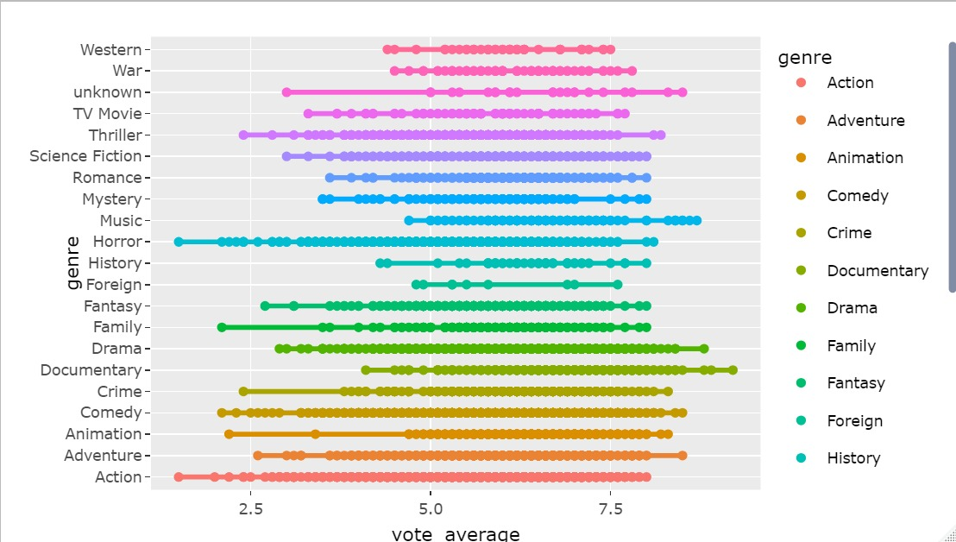
The first plot is the bie chart that we will use to illustrate the main features of the appropriate data distribution. it was used to determine the most movie who get the high vote average, and therefore the most frequent type is mostly the kind that the viewer likes. we can consider this type as the answer to the first question ,it is documentary movies.

Slide 7
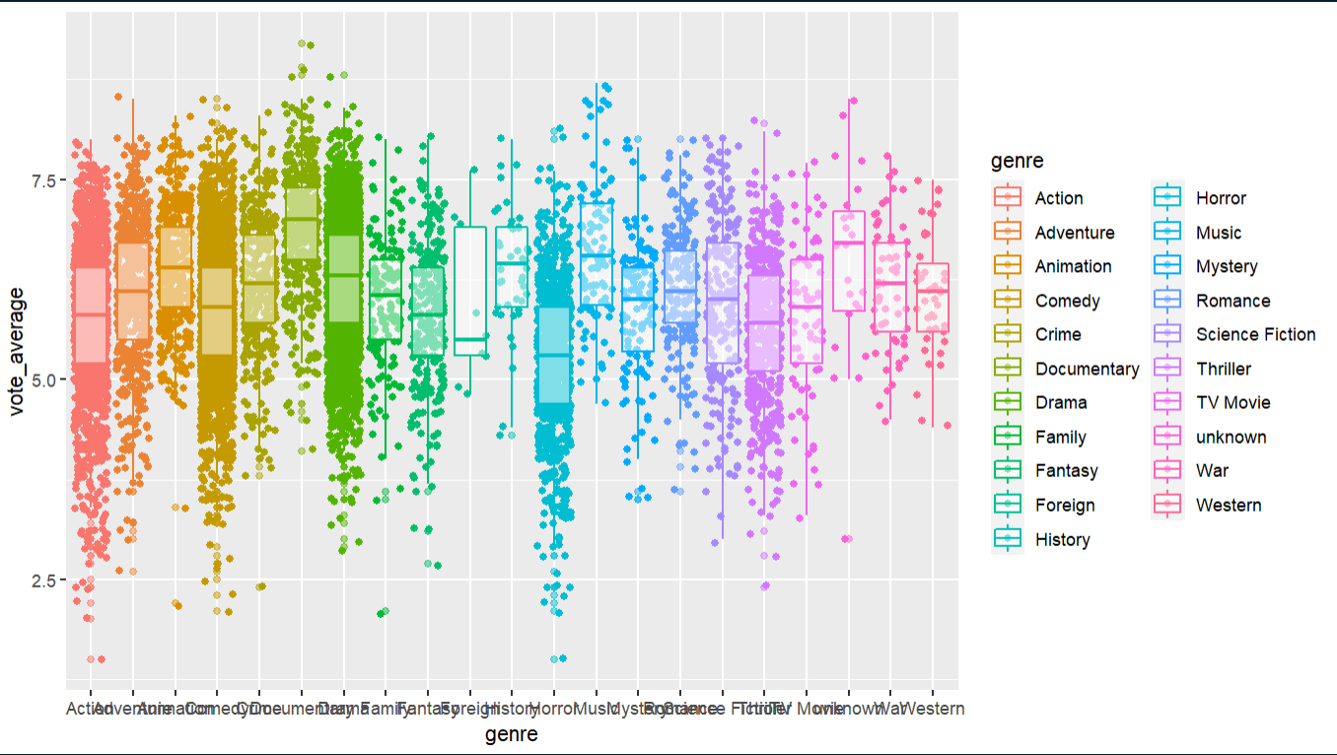
Vote average with genre
Here we realize that the biggest number of vote average is action movies but the highest average is for documentary movies

Slide 8
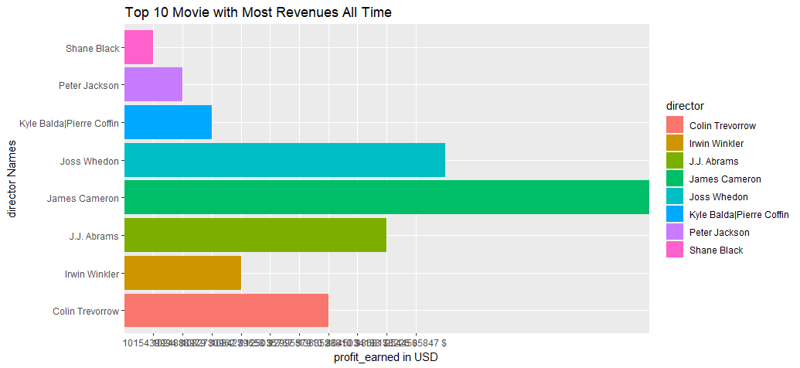
The second plot is the bar plot that we will use to determine top 10 director names with the most profit earned, and to determine whether there is a relationship between director and the profit earned.

Slide 9
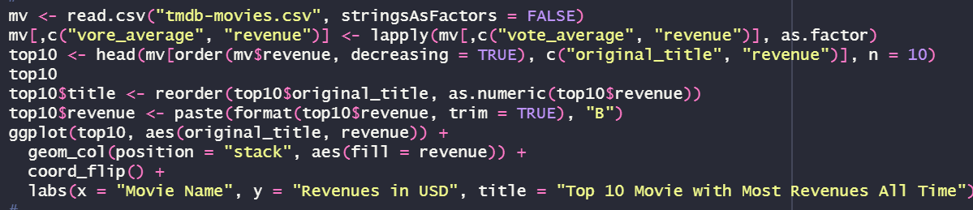
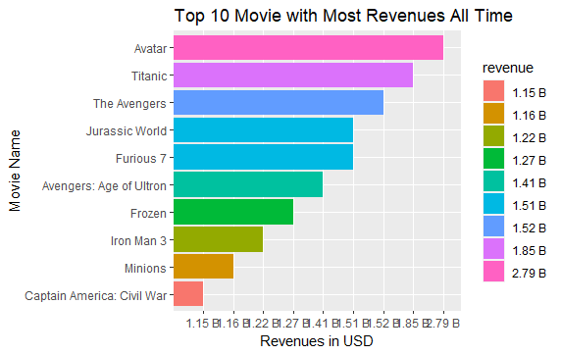
Third plot is a simple sorting for top 10 movies depending on its revenue

Slide 10
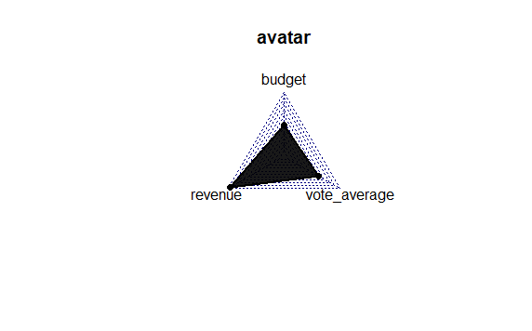
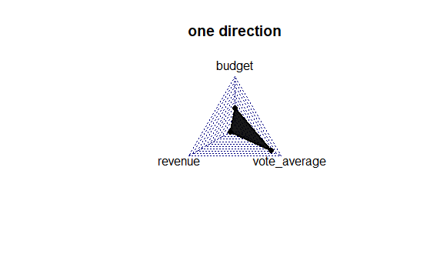
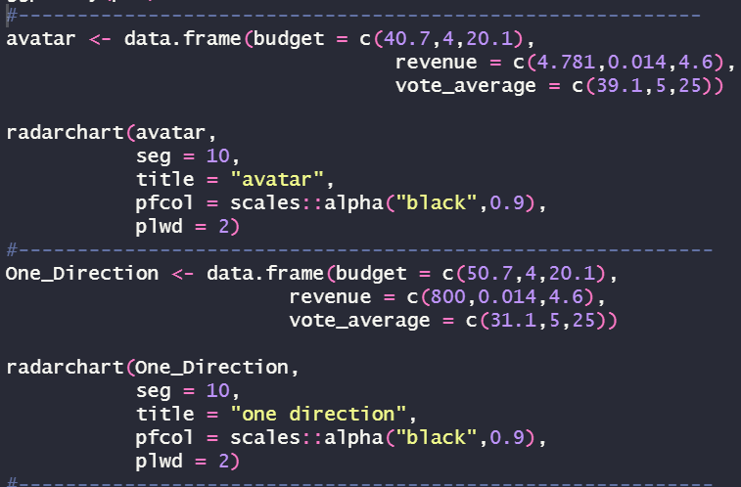
Random samples
But a movie like one direction payed mormal budget and got so low revenue and got the highest vote_average which commit our analysis that budget is near to revenue whatever it’s lower or higher and vote_average is independent from both
we can see here a movie like avatar pays not that much on budget and get the highest revenue which reflected on its rate

Slide 11

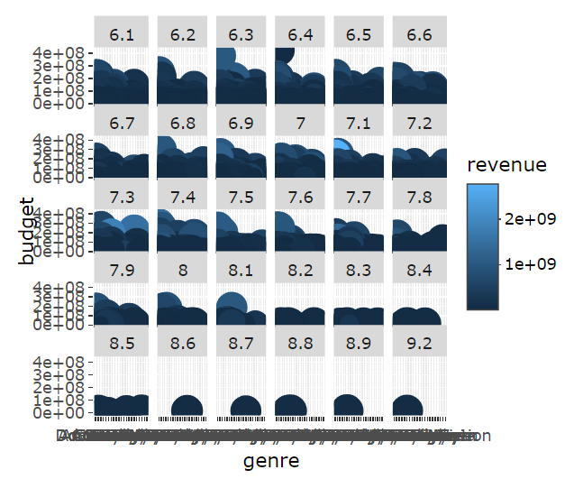
ANOTHER KIND OF MAPPING THE DATA
In this picture we want to know the relation between budget and revenue but under wrapping the vote average which is bigger than 6 and the genre as a factor and we find that when we gets more runtime the less we get revenue and we here realize that revenue is independent for
(runtime + vote average) as we can see most runtime + medium rate like 7.5 give me the highest revenue

Slide 12

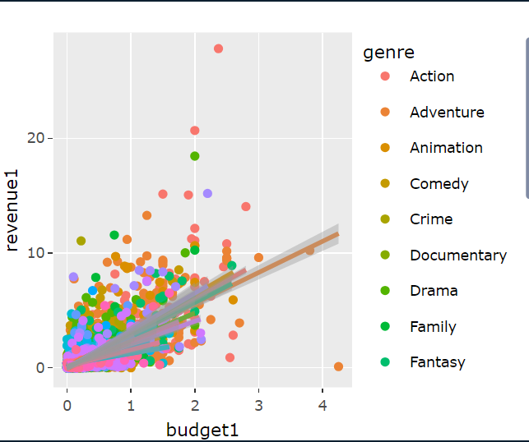
Budget & revenue Relationship
There is a direct relationship (increasing) between the budget and revenue. When adding the vote_average to this relationship, it has been observed that most revenue comes with the most budget.

Slide 13
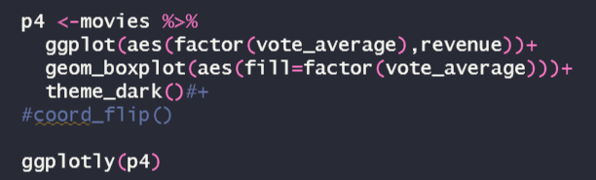
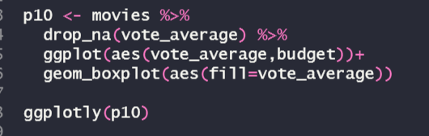
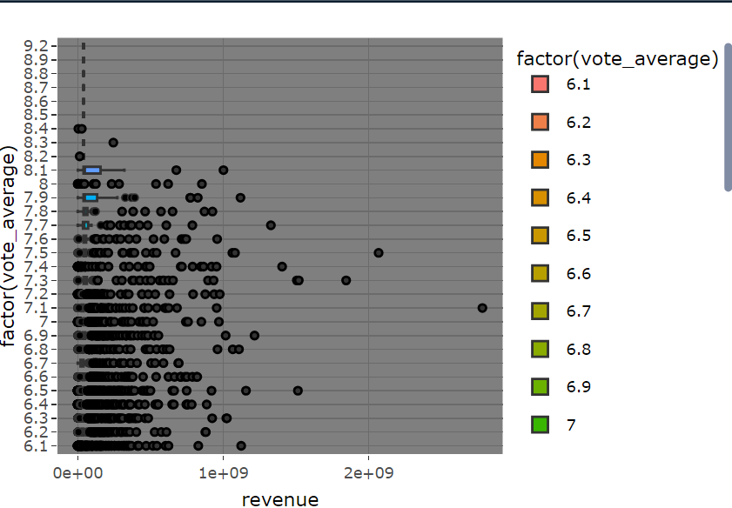
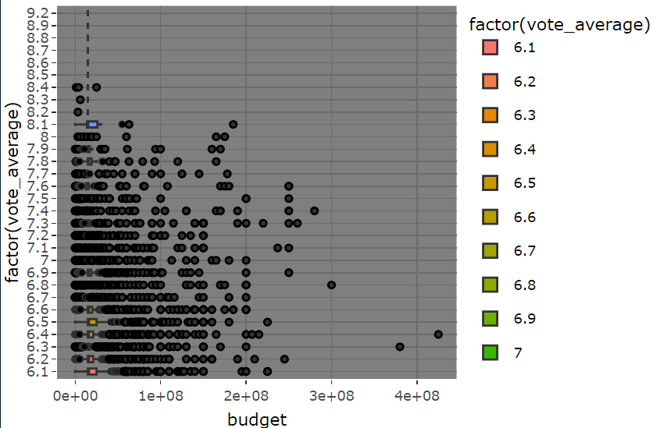
This simple boxplot shows the relation between vote average and revenue we realized that not the most vote_average sector get the most revenue and this is normally like we see here one of (7.2) got the most revenue and
This simple boxplot shows the relation between vote average and budget, and we realize that sometimes they pay a lot of budget and get low average and sometimes they pay for the movie few budget and get the highest average so the rate here is inverse relation between them

Slide 14
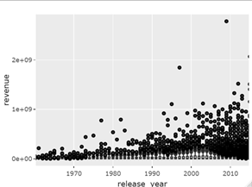
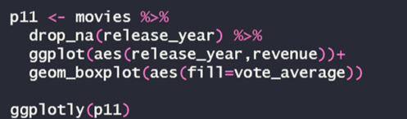
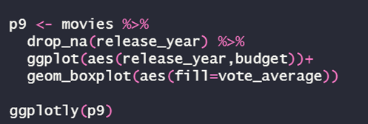
here we see that the newest the movie is the more they make it with budget and the more they get from it revenue

Slide 15
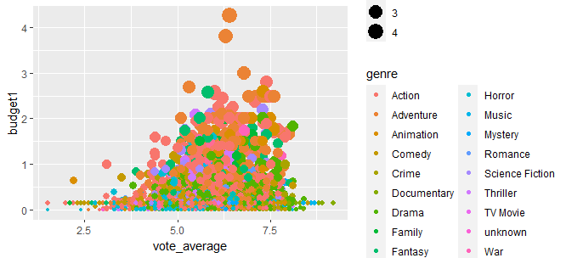
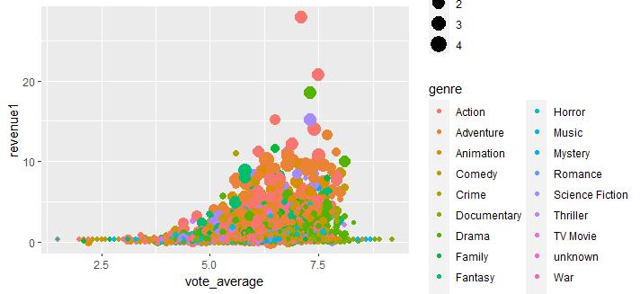
From this plots we realize that most movies costs budget is (action) and it gain the most revenue too

Slide 16

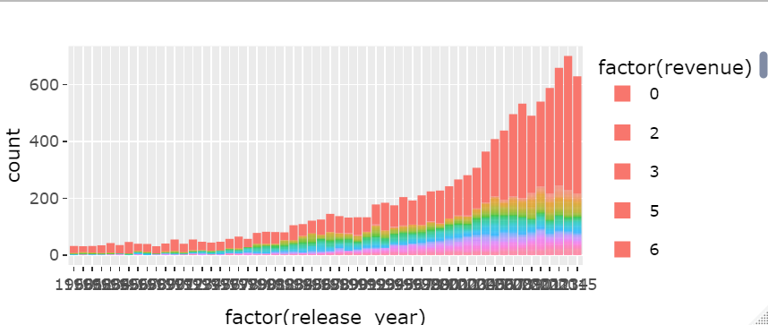
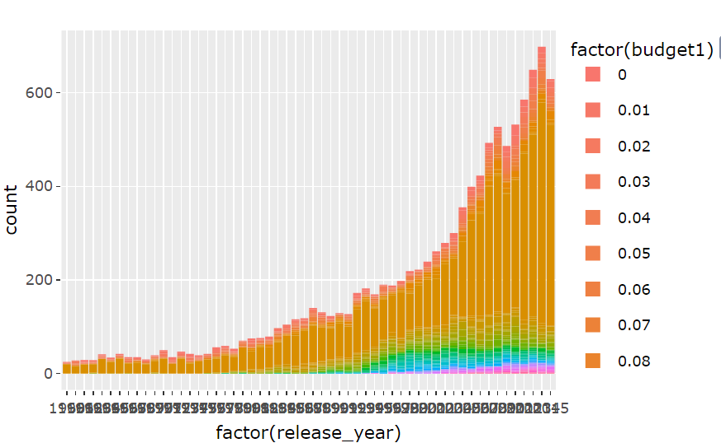
Release year and (revenue,budget)
As we can see here the newer years have more burden with highest revenue

Slide 17

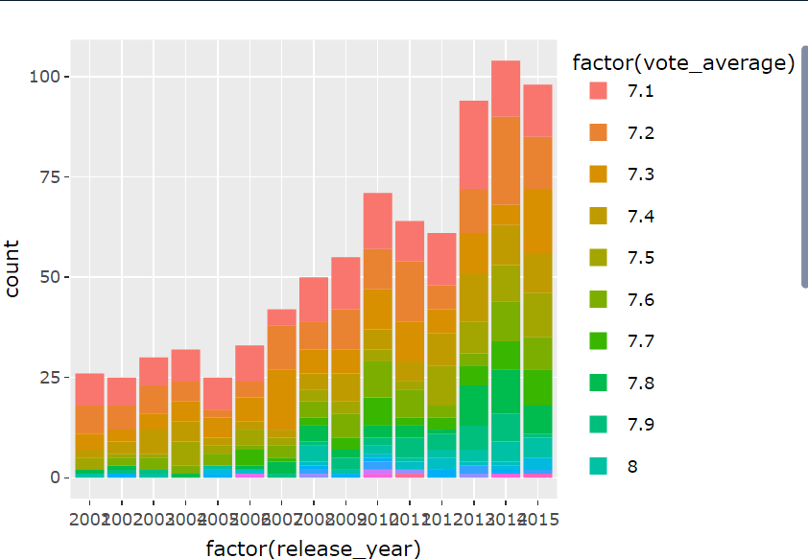
Release year and movie rate
here we see the relation between vote average and release year
And we realize here that least rates is from 2001 to 2017 and rarely to find some movies and every year has all rates’ movies but after 2010 is the highest rates ever but in total view we get that with increasing the year the number of the movies increases and the vote rate is also increasing

Slide 18
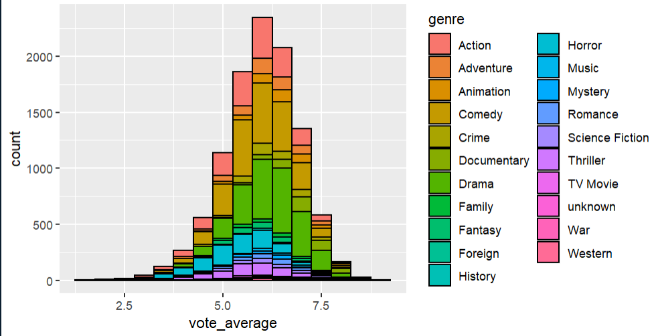
Vote_average and genre relationship
Here we realize that most rated movies are drama, animation documentary and comedy

Slide 19

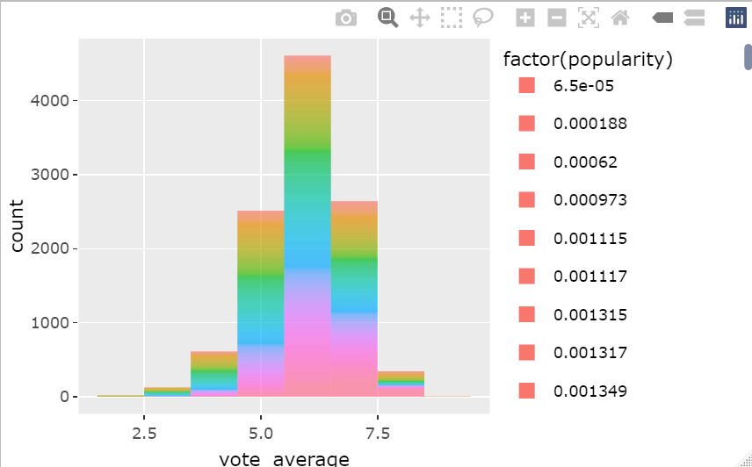
Vote_average and popularity relationship
This histogram shows that the most popular movies gets the highest vote rates and it’s normally to find the medium sector got a lot of popularity too

Slide 20

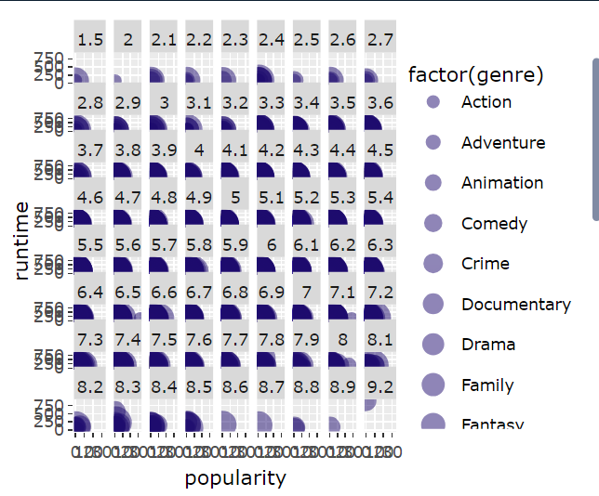
MAPPING THE DATA
As we see here, when popularity increase independently each sector increases too and runtime also make it widder

Slide 21

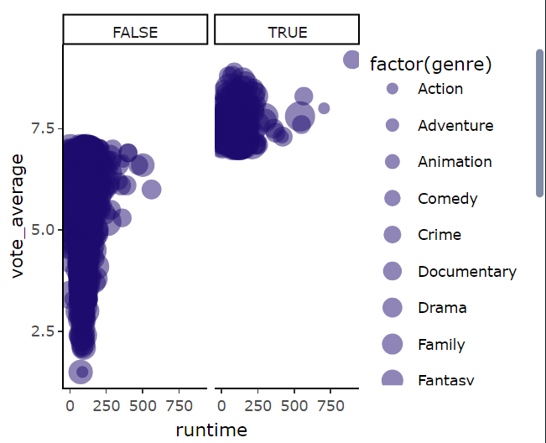
Making Vote_average with runtime relation more clear
To make more obvious we make we limited it to see what runtime exactly do with vote average as we see here low runtime can be with a bad vote average and with a good vote average, but the highest runtime is always having the best vote average.

Slide 22
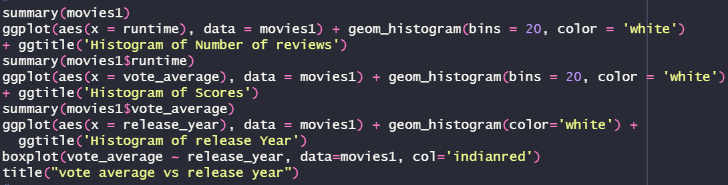
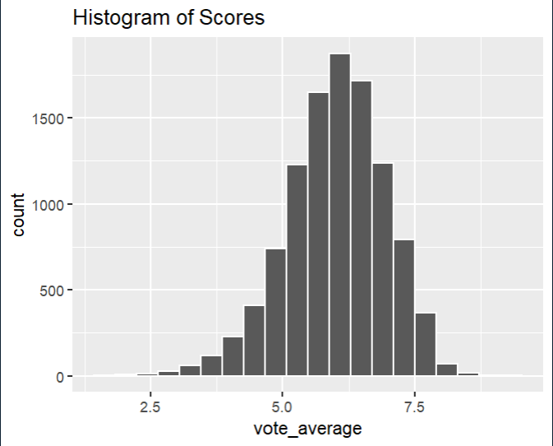
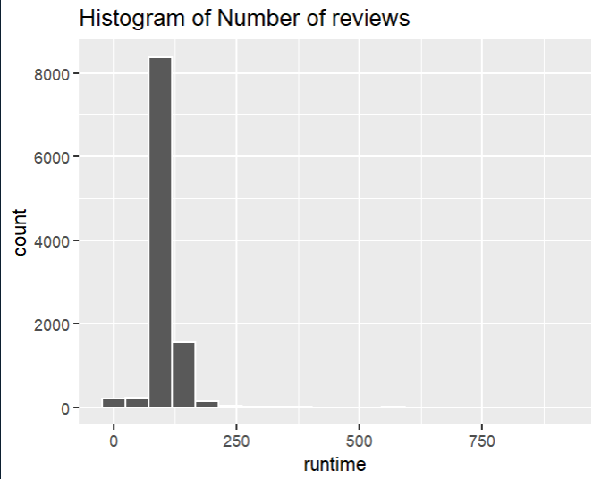
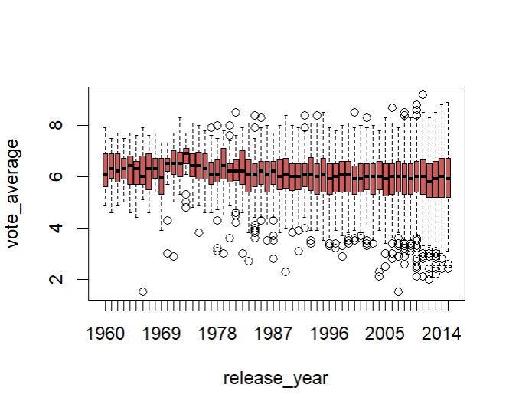
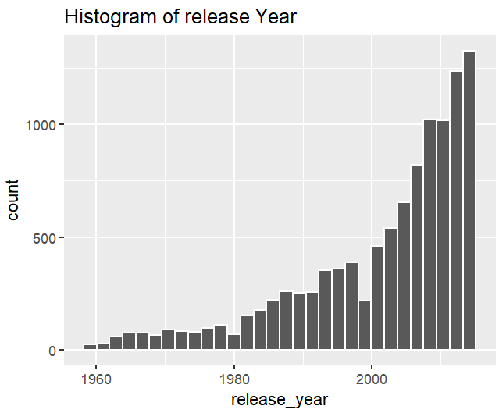
Genres of movies
Most of movies have rate for 4:6 all over years

Slide 23
Scaling and manipulating with data

Slide 24
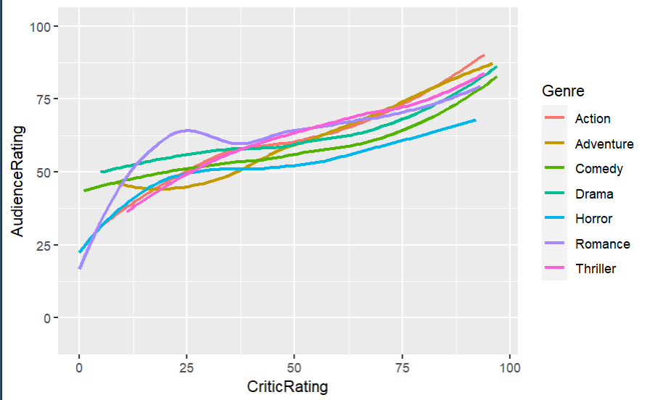
Audience rating and critic rating relation
Here we want to know if there a relation between audience and critic rating, actually we realize that almostly they are neat to each other

Slide 25
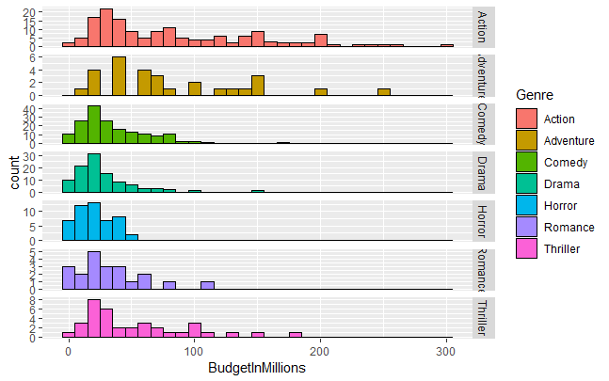
Budget an dgenre realtion
And here we realize that movies which costs most budget are action movies

Slide 26
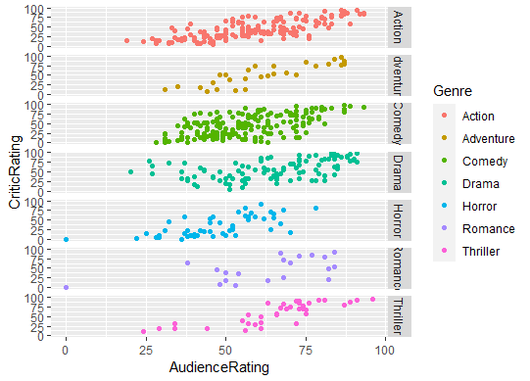
Audience rating and critic rating relation for genres
And here we find out that movies which have most rating whether it’s bad or good rating are comedy movies

Slide 27
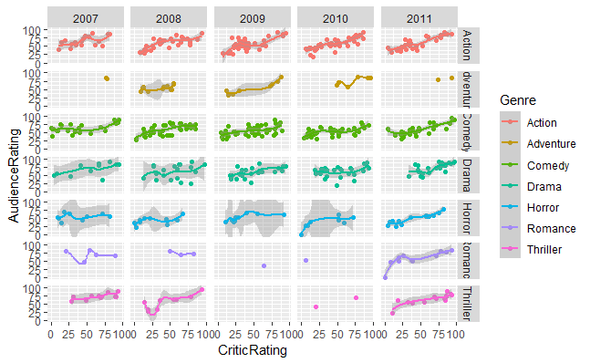
Audience rating and critic rating relation for genres over random years
We realize that action movies are stand still
And adventure movies increases
Comedy are still the same
And horror too are still the same
Romance increase and thriller too increase

Slide 28

According to the visualizations and statistics that are above , we get to produce a good movie and get good revenue , it should be action with long run time .
So film store company decided to produce action movie and documentary movie and try to make it long run time to get high popularity and vote average .

